Slide 1
Digital Portfolio
STUDENT NAME:DEVISREE V
REGISTER NO AND NMID: 222409764& 76EB0E925EE5C9D9D79418112DA4D616
DEPARTMENT: B.Sc COMPUTER SCIENCE
COLLEGE: C M Annamalai Arts & Science College For Women

Slide 2
PROJECT TITLE
Create portfolio using framework

Slide 3
AGENDA
Problem Statement
Project Overview
End Users
Tools and Technologies
Portfolio design and Layout
Features and Functionality
Results and Screenshots
Conclusion
Github Link

Slide 4
PROBLEM STATEMENT
My resumes alone are not enough to showcase skills and projects effectively. Many students and professionals lack of a structed online presence to highlight their work.A Digital fortfolio provides an interactive and accessible to present achievements, skills, and experiences.

Slide 5
PROJECT OVERVIEW
Brief summary of your project.
What your portfolio contains(About Me,Skills,Contact).
Main idea:Showcase pesonal achievements, skills, and projects.

Slide 6
WHO ARE THE END USERS?
Students (academic projects, resumes).
Job seekers( to share with recruiters).
Freelancers(to show clients).
Professionals(to highlight experience and achevements).

Slide 7
TOOLS AND TECHNIQUES
HTML-Structure(pages, sections).
CSS-Styling(colors, layouts, responsiveness).
JAVASCRIPT-Interactivity(navigation menu, animations, form validation).
Mention code editor CODEPEN and hosting platform(GitHub Pages).

Slide 8
POTFOLIO DESIGN AND LAYOUT
Sections include:
Home/About ME
Projects
Skills
Contact
Responsive layout (mobile + desktop view).

Slide 9
FEATURES AND FUNCTIONALITY
Navigation bar with smooth scrolling.
Project showcase with images/details.
Intractive elements (hover effects, animations).
Contact from (with validation).
Responsive design for all devices.

Slide 10
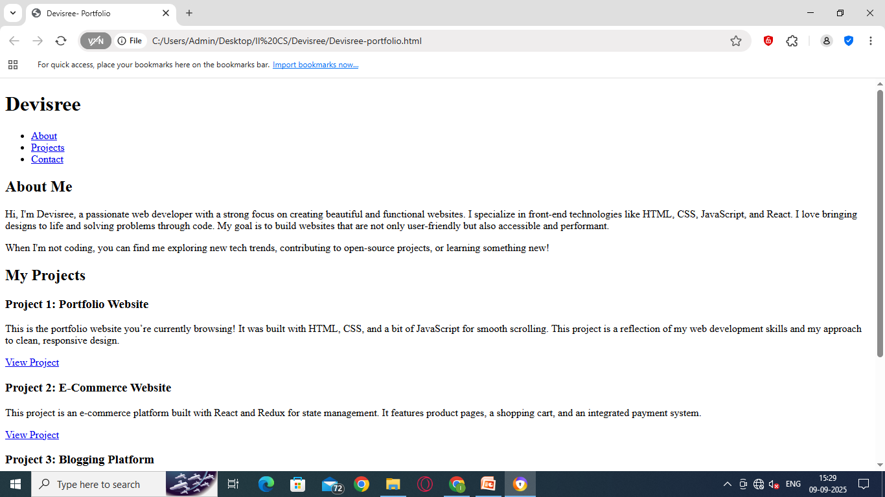
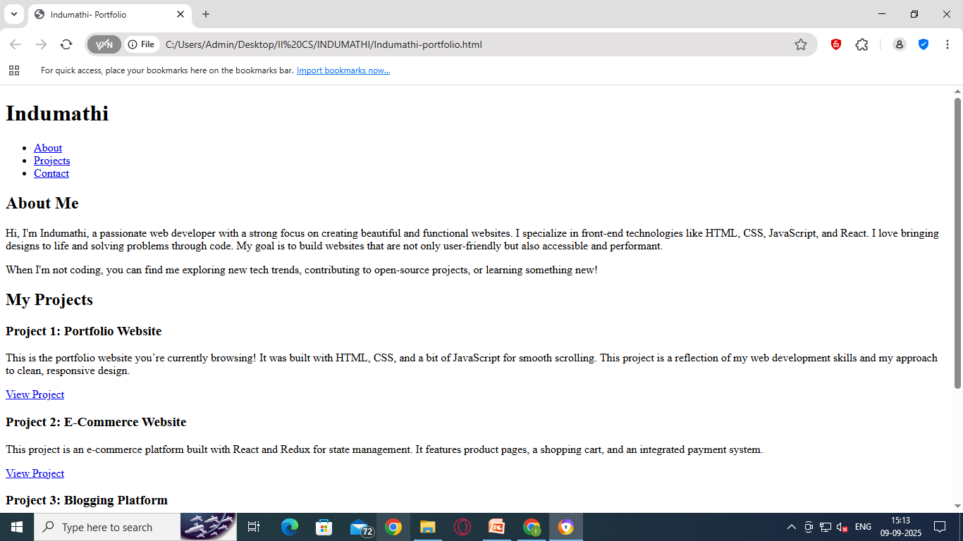
RESULTS AND SCREENSHOTS

Slide 11
CONCLUSION
Highlights of your project
Final Summary
Benefits to society

